Slide 1
Sparse State Preparation
Best Case Scenario - Team 19
Ω(1)

Slide 2
Algorithm 1
The implementation of Algorithm_1 is given however we must decipher the list of operations, ops, which details the gates to be applied to reach the target state
ops1: List of ints that determines which gates should be used and in what order, where each integer corresponds with a quantum gate
ops2: List that gives the index of the qubit where a NOT gate should be applied
ops3: List that gives the indices of the control and target qubits where a CNOT gate should be applied
ops4 : list that gives the phase of RY gate, the index of target qubit, and indices of the control qubit
ops5: bitstring output of algorithm_1 after all circuit operations are applied
n9: n9[i] represents the number of times the gate represented in op1[i] is carried out

Slide 3
Quantum Functions
unitary_control(qubit: QArray[QBit], contrl: QArray[QBit], target: QParam[int])
Applies the control X gate to the target qubit at the imputed index.
y_rotation(theta: QParam[float], reg: QArray[Qbit], target: QParam[int])
Rotates a Qbit in array “QArray” at index “target” about the y-axis a given “theta” degrees from its current position.
my_unitary (q: QArray[QBit], w:QParam[float], target: QParam[int])
Computes y rotation around w, performs X-gate, “uncomputes” y rotation
My_controlled_unitary(q: QArray[QBit], w:QParam[float], ctrl:QArray[QBit], target: QParam[int])
Computes y rotation around w, performs CX-gate, “uncomputes” y rotation

Slide 4
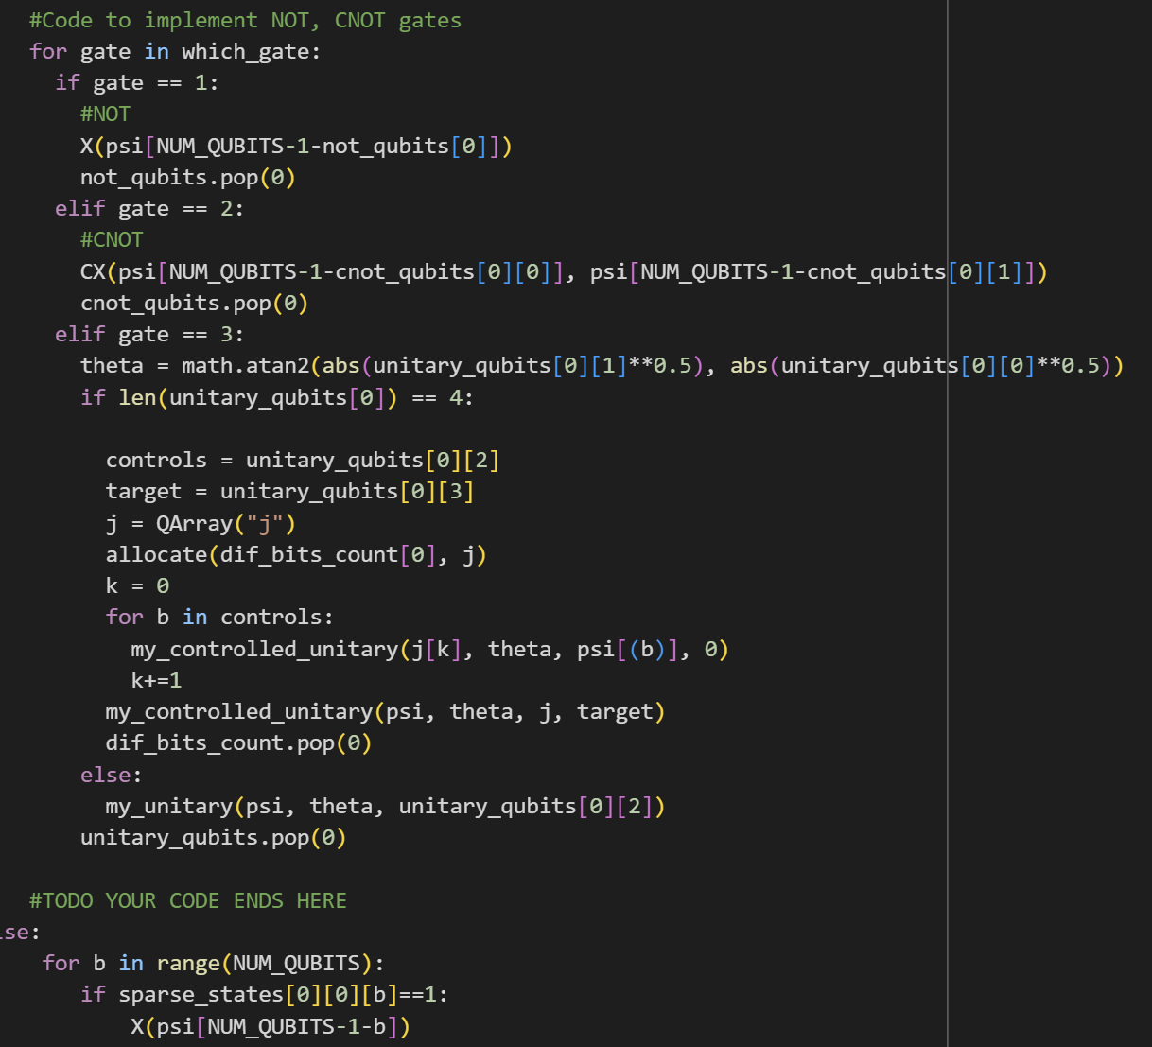
Algorithm 2
The while loop from the article’s pseudocode is handled in the recursive calls to Algorithm_1
Algorithm_2 mainly consists of parsing the data stored in ops1-5 and n9 to build the quantum circuit to create a sparse state.

Slide 5
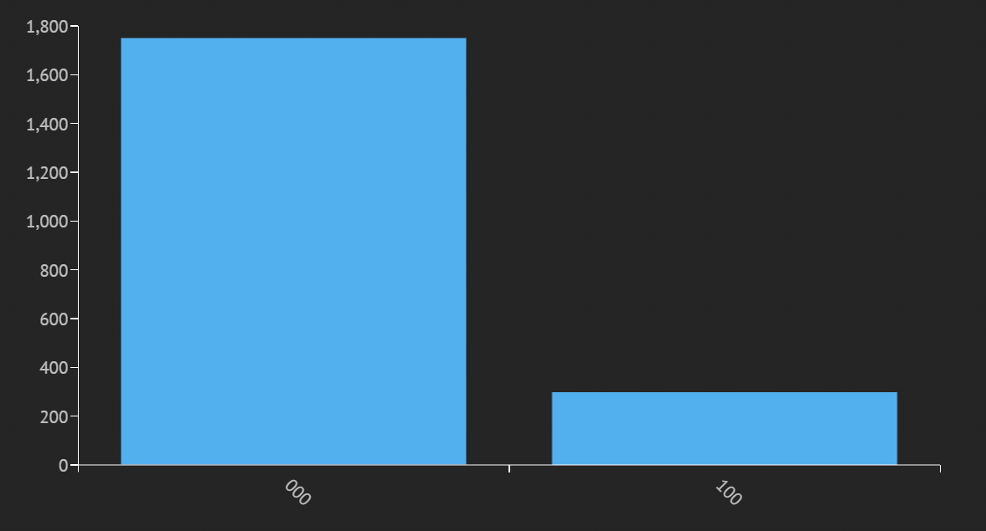
Results

